Slide 1
PHP, Bootstrap, XML and rich snippets
Milan Ojsteršek

Slide 2
PHP – first example
<!DOCTYPE html>
<html>
<body>
<h1>My first PHP page</h1>
<?php
echo "My first PHP script!";
?>
<?php
$txt = „PHP";
echo "I love $txt!";
?>
</body>
</html>

Slide 3
PHP features
PHP is an acronym for "PHP: Hypertext Preprocessor"
PHP is a widely-used, open source scripting language
PHP scripts are executed on the server
PHP files can contain text, HTML, CSS, JavaScript, and PHP code
PHP code are executed on the server, and the result is returned to the browser as plain HTML
PHP files have extension ".php"
PHP can generate dynamic page content
PHP is a Loosely Typed Language
PHP can create, open, read, write, delete, and close files on the server
PHP can collect form data
PHP can send and receive cookies
PHP can add, delete, modify data in your database
PHP can be used to control user-access
PHP can encrypt data

Slide 4
How to install PHP and how to use it
XAMP
WAMP
How to install?
Manuals

Slide 5
PHP in one page
Variables ( local, global , global keyword, globals - associative array, static, super globals).
Constants.
Output (echo, print).
Operators.
Data types (strings, boolean, integer, float, array, multidimensional arrays, date and time, objects).
Statements (if-else-elseif, switch, while, for).
Functions.
Objects.
Forms (handling forms, validation of forms).
Cookies, Sessions, Filters, Files, Mail

Slide 6
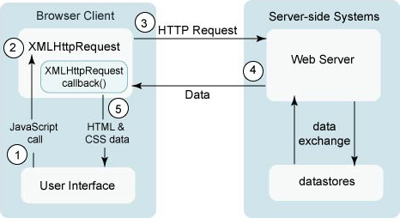
AJAX (Asynchronous JavaScript And XML)

Slide 7
AJAX
AJAX in PHP
  XMLHTTP object
  AJAX request
  AJAX response
AJAX in jQuery
  load
  get/post

Slide 8
Bootstrap
<!DOCTYPE html>
<html lang="en">
<head>
<title>Bootstrap Example</title>
<meta charset="utf-8">
<meta name="viewport" content="width=device-width, initial-scale=1">
<link rel="stylesheet"
href="https://maxcdn.bootstrapcdn.com/bootstrap/3.3.7/css/bootstrap.min.css">
<script
src="https://ajax.googleapis.com/ajax/libs/jquery/3.2.1/jquery.min.js">
</script>
<script
src="https://maxcdn.bootstrapcdn.com/bootstrap/3.3.7/js/bootstrap.min.js">
</script>
</head>
<body>
<div class="container-fluid">
<h1>Hello World!</h1>
<p>Resize the browser window to see the effect.</p>
<p>The columns will automatically stack on top of each other when the screen is less than 768px wide.</p>
<div class="row">
<div class="col-sm-4" style="background- color:lavender;">.col-sm-4</div>
<div class="col-sm-4" style="background- color:lavenderblush;">.col-sm-4</div>
<div class="col-sm-4" style="background- color:lavender;">.col-sm-4</div>
</div>
</div>
</body>
</html>

Slide 9
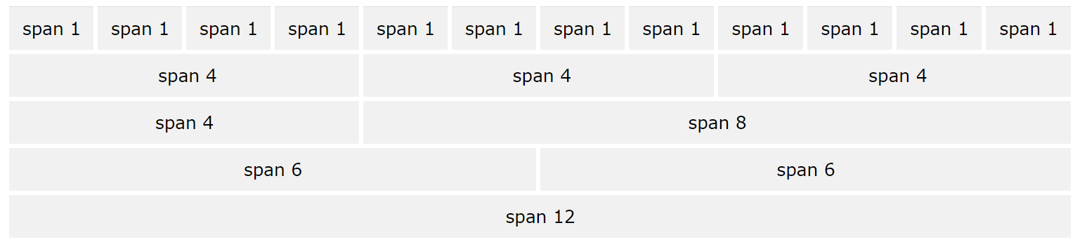
Bootstrap grid
Bootstrap's grid system allows up to 12 columns across the page.
If you do not want to use all 12 columns individually, you can group the columns together to create wider columns
The Bootstrap grid system has four classes:
xs (for phones - screens less than 768px wide)
sm (for tablets - screens equal to or greater than 768px wide)
md (for small laptops - screens equal to or greater than 992px wide)
lg (for laptops and desktops - screens equal to or greater than 1200px wide)
The classes above can be combined to create more dynamic and flexible layouts.
<div class="row">
<div class="col-sm-4">.col-sm-4</div>
<div class="col-sm-8">.col-sm-8</div>
</div>

Slide 10
Bootstrap reference
Bootstrap CSS Ref
  CSS All Classes, CSS Typography, CSS Buttons, CSS Forms,
  CSS Helpers, CSS Images, CSS Tables, CSS Dropdowns, CSS Navs, Glyphicons
Bootstrap JS Ref
  JS Affix, JS Alert, JS Button, JS Carousel, JS Collapse, JS Dropdown, JS Modal, JS Popover, JS Scrollspy, JS Tab, JS Tooltip.

Slide 11
XML
<bookstore>
<book category="children">
<title>Harry Potter</title>
<author>J K. Rowling</author>
<year>2005</year>
<price>29.99</price>
</book>
<book category="web">
<title>Learning XML</title>
<author>Erik T. Ray</author>
<year>2003</year>
<price>39.95</price>
</book>
</bookstore>
XML element: <price>29.99</price>
XML atribute: <book category="children">

Slide 12
XML namespaces
<root>
<h:table xmlns:h="http://www.w3.org/TR/html4/">
<h:tr>
<h:td>Apples</h:td>
<h:td>Bananas</h:td>
</h:tr>
</h:table>
<f:table xmlns:f="https://www.w3schools.com/furniture">
<f:name>African Coffee Table</f:name>
<f:width>80</f:width>
<f:length>120</f:length>
</f:table>
</root>

Slide 13
XML standards
XML DOM
XML XPath
XML XSLT
XML XQuery
XML DTD
XML Schema
XML AJAX
XML Services

Slide 14
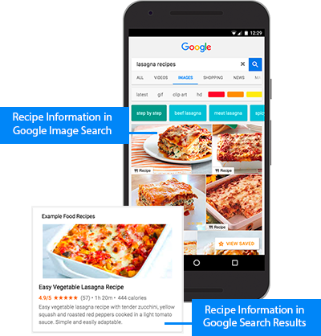
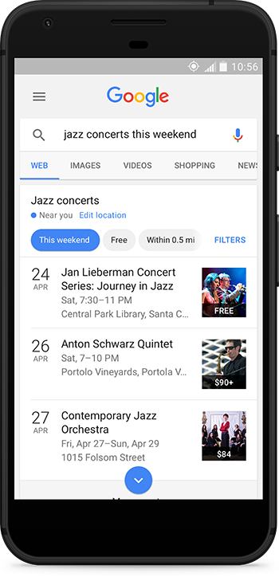
Rich snippets
Schema.org
Examples:
Person
Organization
Place
Event
Articles
Local Businesses
Music
Recipes
Reviews
TV & Movies
Videos

Slide 15
RDFa
<div vocab="http://schema.org/" typeof="Person">
<span property="name">George Bush</span>, the
<span property="disambiguatingDescription">41st President of the United States</span>
is the father of
<div property="children" typeof="Person">
<span property="name">George W. Bush</span>, the
<span property="disambiguatingDescription">43rd President of the United States</span>.
</div>
</div>

Slide 16
HTML5 microdata
<div itemscope itemtype="http://schema.org/Person">
<span itemprop="name">George Bush</span>, the
<span itemprop="disambiguatingDescription">41st President of the United States</span>
is the father of
<div itemprop="children" itemscope itemtype="http://schema.org/Person">
<span itemprop="name">George W. Bush</span>, the
<span itemprop="disambiguatingDescription">43rd President of the United States</span>.
</div>
</div>

Slide 17
JSON-LD
<script type="application/ld+json">
{
"@context": "http://schema.org",
"@type": "Person",
"name": "George Bush",
"disambiguatingDescription": "41st President of the United States",
"children": {
"@type": "Person",
"name": "George W. Bush",
"disambiguatingDescription": "43rd President of the United States"
}
}
</script>

